Slide 1
Greenhouse Gas
Emission in the Agriculture sector
Innovative technologies for climate change mitigation by Mediterranean agricultural sector– Clima MED
LIFE17 CCM/GR/000087
https://life-climamed.eu/home

Slide 2
Sectoral Share of GHG emissions
Energy use is a major contributor of GHG accounting for 73.6% of the total GHGs. This includes emissions from the combustion of fossil fuels for electricity generation, transportation, heating, and industrial processes
Agriculture and land use change is the second largest sectoral contributor mainly because of methane emissions, deforestation and other land management practices

Slide 3
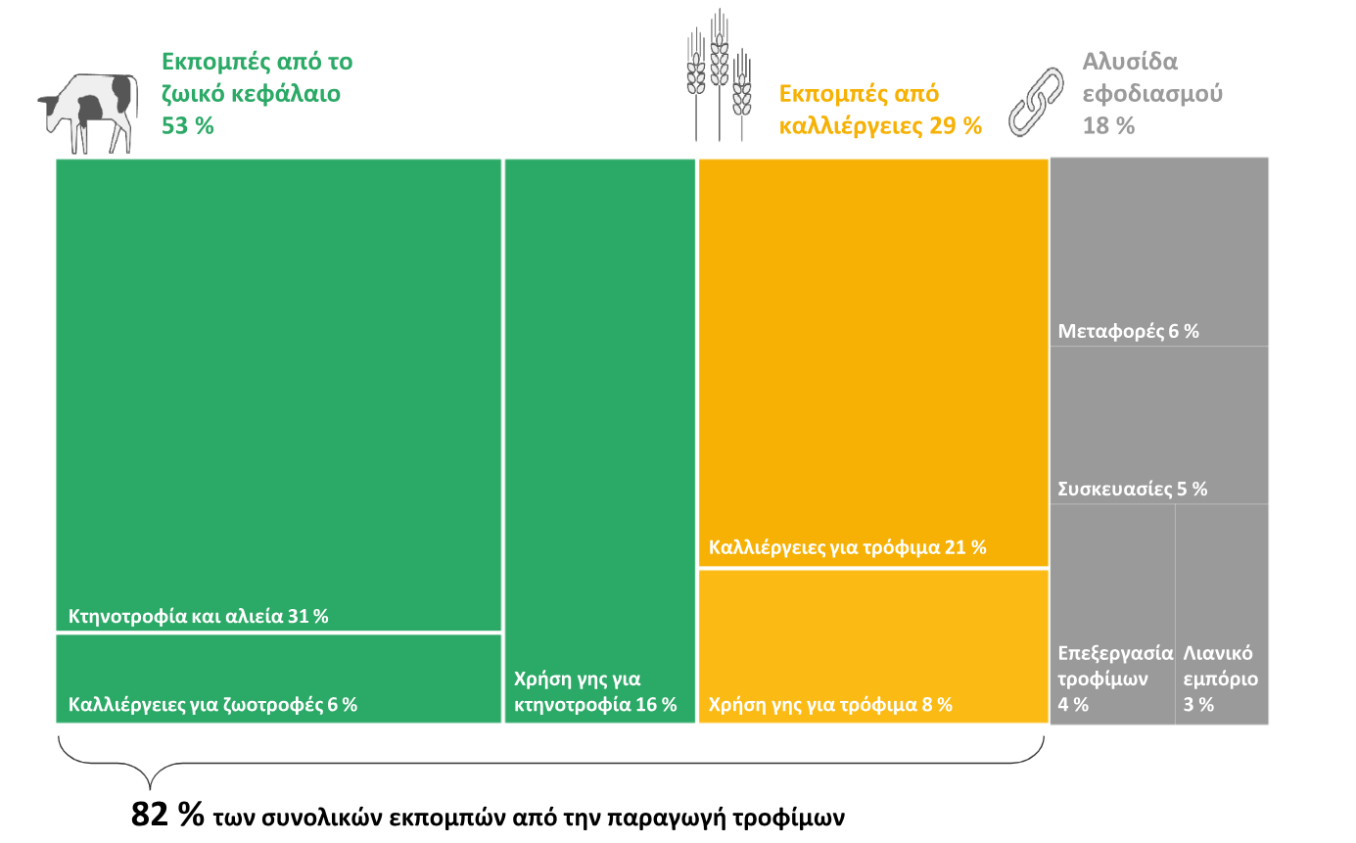
Greenhouse Gas Emissions (GHG) from Agriculture
Emissions from livestock
54%
Emissions from crops
29%
Supply chain 18%
Transportation 6%
Packaging 5%
Food production 21%v
Livestock and Fisheries 31%
Food processing 4%
Retail Market 3%
Land Use for Livestock 6%
Crops and Animal Feed 6%
Land Use for Food 21%
of the total emissions from food production

Slide 4
Agricultural emissions per country 2020 (million tonnes)

Slide 5
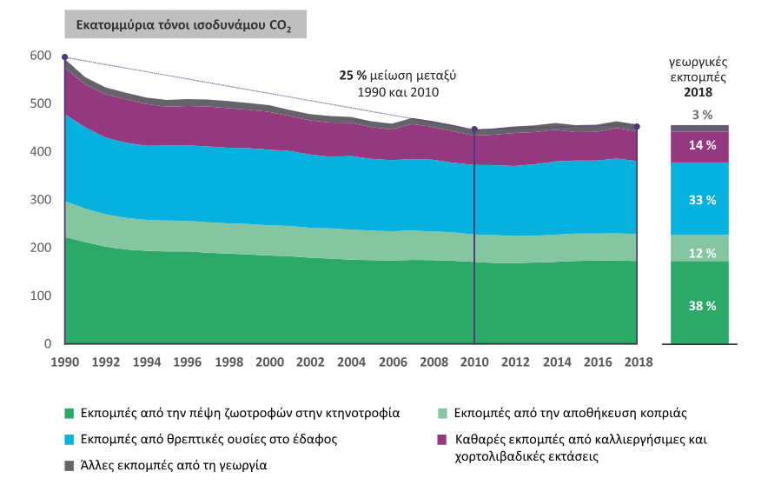
Net Greenhouse Gas Emissions from
Agriculture in the EU-27 since 1990
CO2 equivalent (million tones)
Agricultural
emissions
25% reduction between 1990 and 2010
Emissions from food digestion in livestock production
Emissions from nutrients in the soil
Other emissions in agriculture
Emissions from manure storage
Net emissions from crops and grasslands

Slide 6
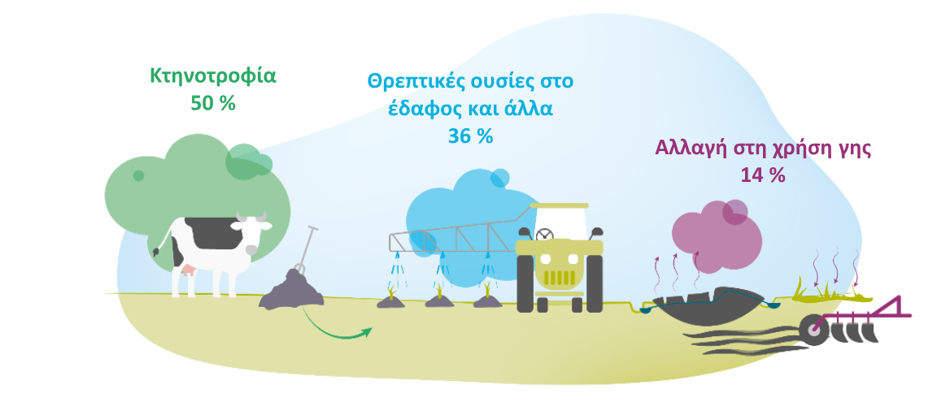
GHGs from Agriculture
Livestock
50%
Soil Nutrients and other
36%
Mainly carbon dioxide (CO₂) from:
Cultivation of drained organic soils
Carbon sequestration in grassland and cropland
Mainly Methane (CH₄) from:
Animal feed digestion from cattle and sheep
Storage of cattle and pig manure
Land Use change
14%
Mainly nitrous oxide (N₂0) from:
Spreading of chemical fertilizer
Manure spread by farmers or deposited by grazing cattle

Slide 7
GHGs emissions in agriculture

Slide 8
Carbon Dioxide (CO₂)
Carbon dioxide is absorbed by trees, pasture and crops through photosynthesis and converted to other complex carbon compounds and oxygen.
Unsustainable farming practices make agriculture a significant source of CO₂ emissions primarily through the release of carbon stored in soils and vegetation.

Slide 9
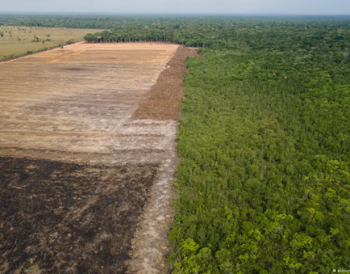
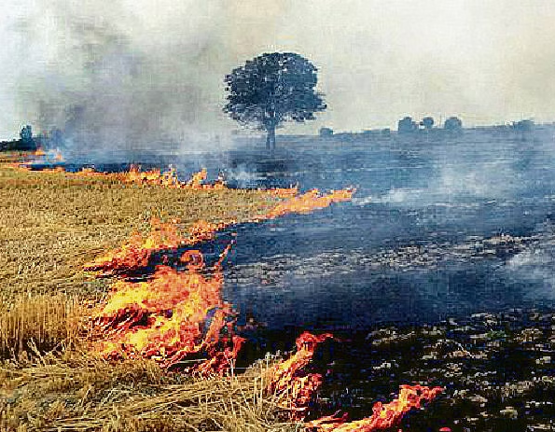
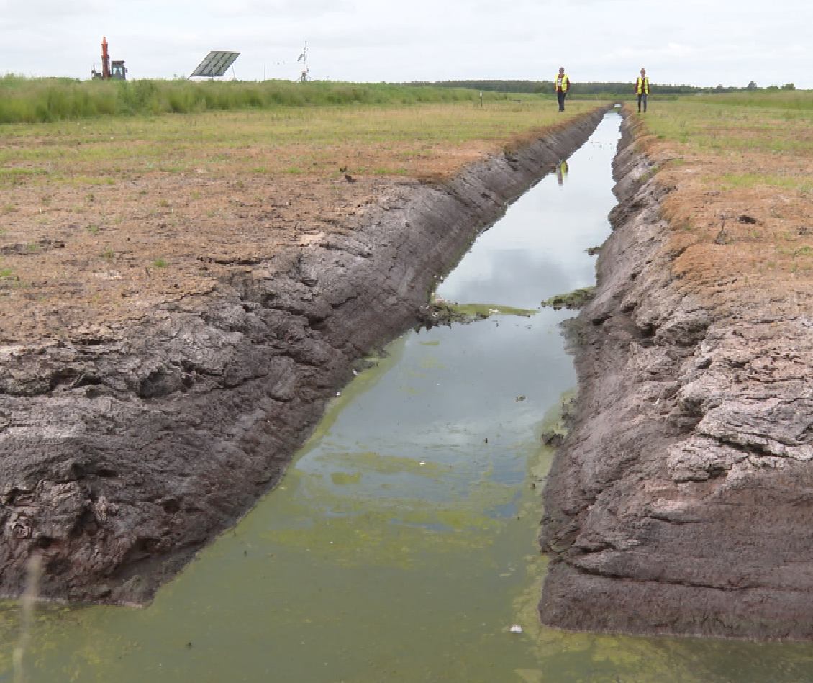
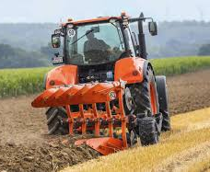
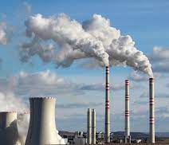
CO₂ sources in agriculture
Deforestation | Crop Residues | Peatland Drainage | Tilling, Liming and Fertilizer Use | Energy Use/ Fuel Combustion
Trees and vegetation that store carbon are removed, releasing stored carbon in biomass and soils | Burning crop residues or decomposition by soil microorganisms release CO₂ as a by-product | Draining peatlands exposes peat soil to oxygen, favoring the decomposition of organic matter that releases CO₂ | Soil disturbance and the application of lime or certain fertilizers can influence the carbon cycle | Tasks such as irrigation, machinery operation, heating, cooling and the production of fertilizers and pesticides require energy in the form of electricity or fuel combustion

Slide 10
CO₂ emissions reduction practices
Cover Crops and Rotational Grazing
  Cover crops improve soil health, reduce erosion, and sequester carbon in the soil, mitigating greenhouse gas emissions.
Agroforestry and Afforestation
  Integrating trees into agricultural landscapes through agroforestry practices can sequester carbon in trees and soil.
  Planting trees on marginal or degraded land through afforestation can contribute to carbon sequestration.

Slide 11
CO₂ emissions reduction practices
Reduced Tillage and No-Till Farming:
  Reduced tillage and no-till practices can improve soil structure, increase organic matter content, and reduce carbon dioxide emissions from soil disturbance
Renewable Energy Use:
  Renewable energy sources such as solar panels and wind turbines can sustain the energy needs of farming operations, offsetting greenhouse gas emissions from fossil fuel such as carbon dioxide

Slide 12
Methane (CH₄)
After carbon dioxide (CO₂), methane (CH₄) is the second most important greenhouse gas, responsible for 20% of the global warming since pre industrial times.
Methane emissions have 27 times higher Global Warming Potential (GWP) than CO₂ on a 100 years time horizon. Worldwide methane emissions are estimated to be 8.5 million kt CO2 eq. Agricultural sector has the highest share, emitting 3.53 million kt CO2 eq. (42%).

Slide 13
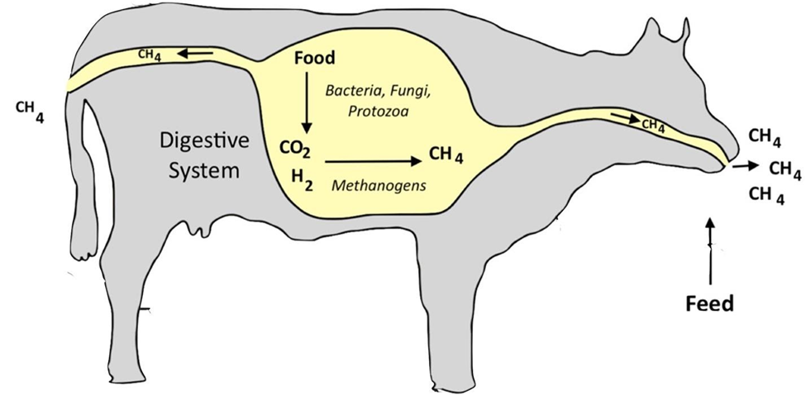
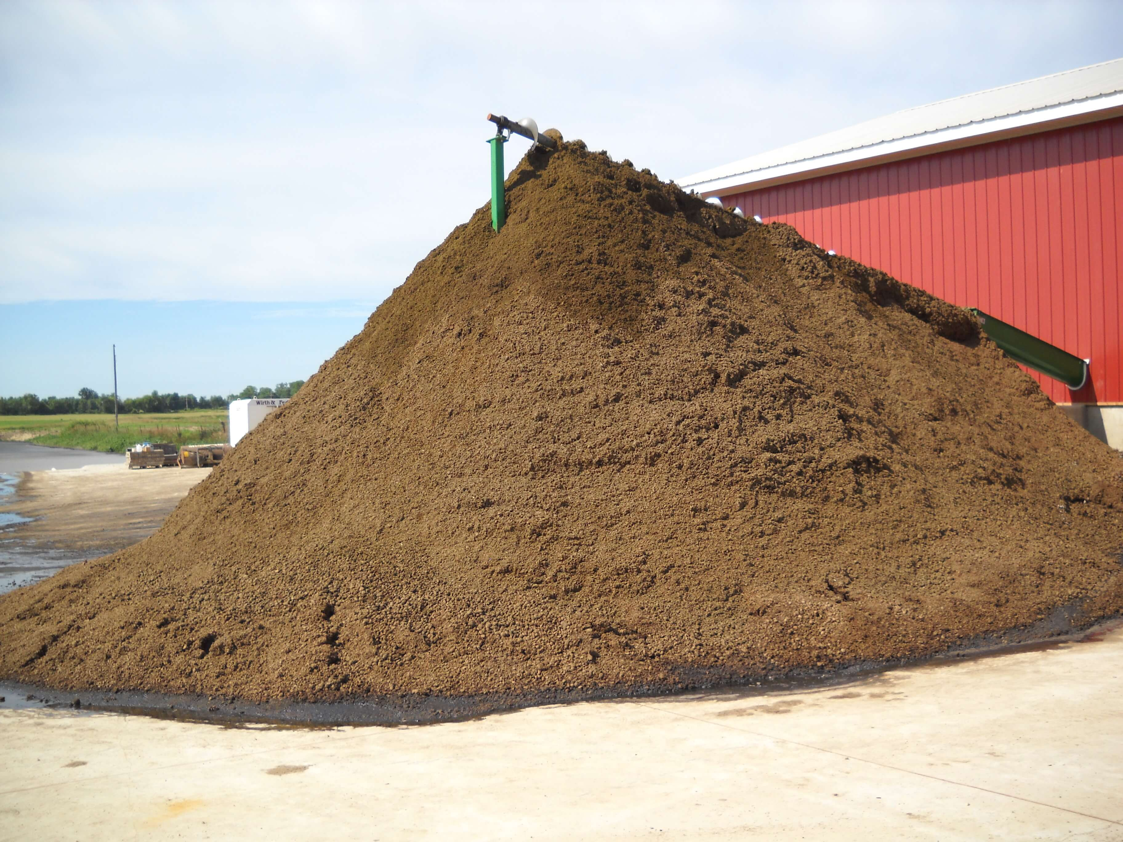

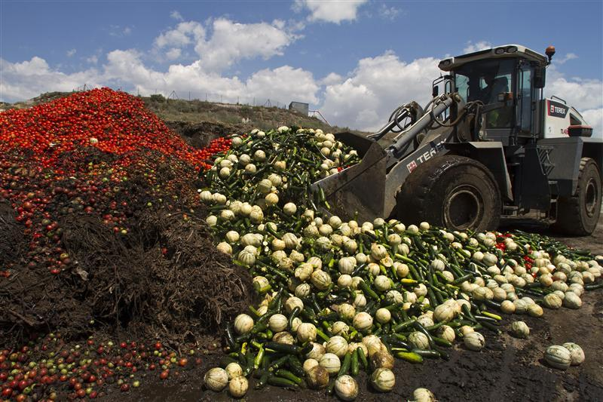
Methane Sources
Enteric Fermentation | Manure Management | Rice Paddy Fields | Organic Waste Decomposition
Enteric fermentation is the largest source of methane emissions from agriculture. Ruminant animals (cattle, sheep and goats), have a specialized stomach called a rumen, where microbial fermentation takes place during digestion. Microbes break down complex carbohydrates, producing methane as a metabolic byproduct. | Manure produced by livestock contains organic matter that can undergo anaerobic decomposition during storage or application to fields, leading to methane production | Rice cultivation involves flooded fields, creating anaerobic conditions in the soil. The conditions favor the decomposition of organic matter and the growth of methanogenic microbes. | Organic waste from agricultural activities, such as crop residue and food waste, can produce methane when it decomposes under anaerobic conditions. This can happen in fields, landfills, and compost piles.

Slide 14
Methane emissions reduction practices
Manure Management
  Biogas production from anaerobic digestion of manure
  Covered manure storage facilities to prevent methane release
Improved rice cultivation
  Using alternate wetting and drying (AWD) or aerobic rice cultivation practices can reduce methane emissions from paddy fields.
  Employing intermittent flooding and water management techniques can minimize anaerobic conditions that lead to methane production
Sustainable Livestock Production:
  Select livestock breeds with lower methane emissions and improved feed conversion rates can help reduce emissions per unit of production.
  Implementing feed additives that inhibit methane production in the stomachs of ruminant animals

Slide 15
Nitrous oxide (N₂O)
Nitrous oxide (N2O) is the third most important greenhouse gas, responsible for 6,5 % of the global warming since pre Industrial times. Nitrous oxide remains for about 121 years in the atmosphere, but because of the strong absorption capacity, it has 298 times more GWP than CO2. Annual globally averaged N2O concentration was 331 parts per billion in 2018, a 22% increase since 1750. Agriculture has the highest share emitting 2.3 million kt CO2 eq.

Slide 16
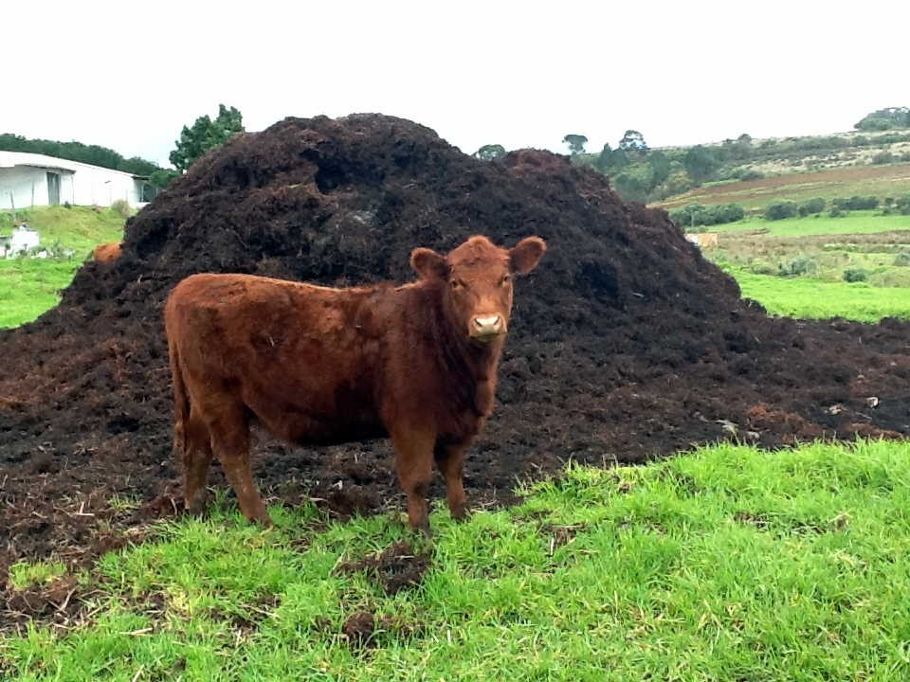
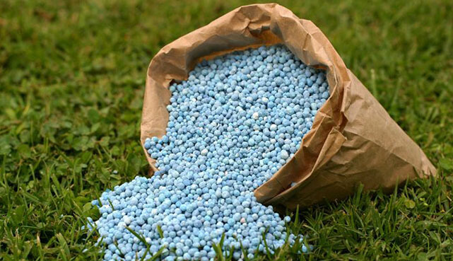
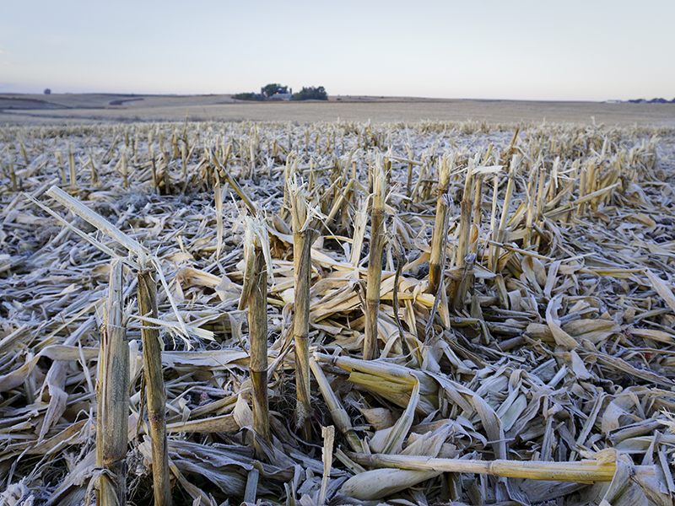
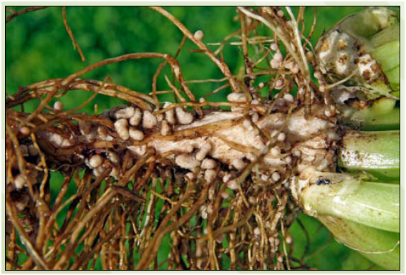
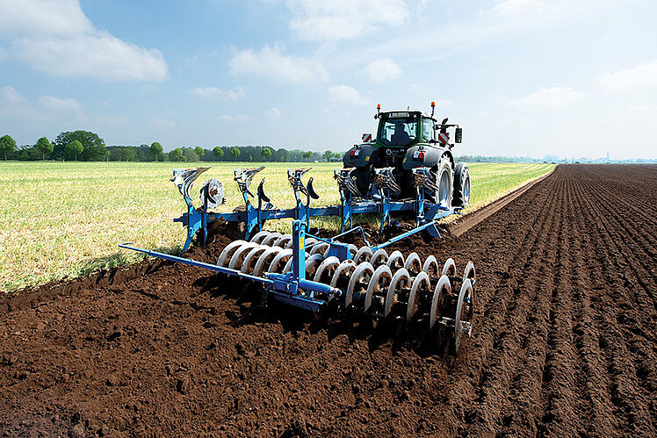
Nitrous Oxide Sources
Manure | Fertilizers | Crop Residues | Nitrogen-fixing crops | Soil Management
Manure from livestock, contains nitrogen compounds that can undergo similar processes of nitrification and denitrification, leading to nitrous oxide emissions. The emissions are influenced by how manure is handled, stored, and applied to fields. | The use of synthetic fertilizers, especially nitrogen-based fertilizers, increases the available nitrogen to microbes, which turn it into nitrous oxide emissions | Decomposition of crop residues and organic matter in the soil under anaerobic conditions can also release nitrous oxide. | Nitrogen-fixing legumes and trees can stimulate nitrous oxide emissions under certain conditions. | Soil management practices can disrupt the natural balance of nitrogen in the soil promoting the release of nitrous oxide.

Slide 17
Nitrous Oxide reduction practices
Nutrient Cycling and Recycling:
  Implementing nutrient cycling practices, such as using crop residues as organic fertilizer, can reduce the need for synthetic fertilizers and associated emissions.
Efficient Fertilizer Management
  Adopt precision agriculture techniques to optimize fertilizer use, reducing excess nitrogen that leads to nitrous oxide emissions.
  Use slow-release or controlled-release fertilizers that minimize nitrogen losses and improve nutrient uptake by crops

Slide 18
Future Trends
Agriculture practices need to be evolved towards a more sustainable orientation
Carbon sequestration potential of agricultural soils must be put into effective action
Management practices that are reported to sequester soil carbon vary mostly between 0.1-1.0 ton C ha-1yr-1 = 0.37-3.7 ton CO2ha-1yr-1
Methane emissions in Europe have decreased by 36%, compared to 1990 levels. However, further acceleration in the downtrend is needed to achieve 2030 and 2050 goals
Soil N2O emissions are expected to increase due to increasing temperature and precipitation
New technologies and better data are enabling the industry to cut nitrogen use

